Slide 1
Best Practices for Administering RStudio in Production
Nathan Stephens

Slide 2
Overview

Slide 3
Solutions engineering
We help you integrate RStudio products into your systems
Our team
Where do we hang out?
Community.rstudio.com
Github.com/sol-eng
Solutions.rstudio.com
Support.rstudio.com
Docs.rstudio.com

Slide 4
Who is this webinar for?
R Admin – data scientists who want to do more
R Evangelists
IT/Ops
Anyone who wants to try RStudio professional products

Slide 5
RStudio
RStudio empowers individuals to be productive with data science.
Open source and reproducible research
APIs and interoperability
Usability and clear documentation
Inclusive and collective success
Creating lasting value for data science

Slide 6
What we do
RStudio builds open source and professional software for data science
Our professional features include things like
Security
Authentication
Load balancing
Support
RStudio professional products
RStudio Server Pro
RStudio Connect
RStudio Package Manager

Slide 7
What is the relationship between R and RStudio?
We don’t own R, package R, or distribute R
R Core team: 20 members – Zero from RStudio
RStudio products “sit on top of R”
You standardize on R first
Install our products second
We assume you have chosen to invest in R

Slide 8
Professional R tooling and integration
Legitimacy
Recognize R as an analytic standard
Competencies*
Understand and manage R tooling
Adoption
Rely on integrated R based solutions

Slide 9
Administering RStudio professional products
People want to know if they are doing things the best way
R is relatively unknown in most organizations
No single place to get all the information you need
Hard to see the forest through the trees
We see a lot of trial and error
Organizational hurdles
Resource limitations

Slide 10
Outline
I want to share some best practices for managing RStudio in production
Share product requirements
Some tips
A path for getting started
Goal is to give you a big picture view of what success looks like, assuming you are using RStudio professional products

Slide 11
5 Best practices for administering RStudio in production

Slide 12
1. Keep your system up to date
Modern tools
Operating system
Browsers
C++11 compiler
R packages on Linux must be compiled
Internet access
R packages

Slide 13
2. Support multiple versions of R
Why do you want to run multiple versions of R?
Manage upgrades of R
Test code on a variety of R versions and distributions
Support projects that depend on various versions of R
All products support multiple versions of R
Upgrade yearly (version 3.1.0+)
Build R from source
Multiple versions of R side by side requires you build R from source
Not hard to do (i.e. config/make/make install)
Instructions

Slide 14
3. Organize your R packages
R Packages rule the nest.
Packages will drive your R version, Linux dependencies, and even your operating system
Data scientists will want access to their most beloved packages
Managing packages for a single user is easy.
Managing packages for an entire platform is hard
RStudio Package Manager solves several problems
Disconnected, air-gapped environments
Curate packages into multiple repositories for security and control
Share internal packages

Slide 15
4. Use root privileges
The group in your organization that installs, configures, and manages R and RStudio will need root privileges
RStudio products
Installs require root privileges
Runs require root privileges
RStudio Server Pro runs as the root user in order to create new R sessions on behalf of its users
RStudio Connect runs as the root user in order to isolate applications and processes
R
System-wide installations of R on Linux often involve root also

Slide 16
5. Securely manage your users
R programmers - RStudio Server Pro
They will need access to R, file shares, databases, and probably many other sensitive systems.
R processes run as the user under a local account
End users - RStudio Connect
End users consume apps and reports.
R Processes typically run under a service account

Slide 17
Authentication
Your organization
Probably has strong opinions on how to authenticate users
This space is only getting more fragmented not less
LDAP, Active Directory, PAM, OAuth, Okta, Duo, Auth0, etc.
Proxied authentication
If we don’t support your specific system, then you can use our proxied authentication
With proxied auth, users do not log in through RStudio but through a proxy that you set up

Slide 18
Supported Auth Methods
RStudio Server Pro
PAM (LDAP and Active Directory)
OAuth 2.0 using Google Apps
Proxied authentication
RStudio Connect
LDAP and Active Directory
OAuth 2.0 using Google Apps
PAM
SAML [Beta]
Proxied authentication

Slide 19
Recommendations (your Happy path)
1. Keep your operating systems and browsers up to date
2. Plan to support multiple versions of R by building R from source
3. Organize your R packages for reliability and consistency
4. Use root privileges to install and run RStudio products
5. Securely manage your R programmers and end users

Slide 20
Getting Started

Slide 21
Tooling
RStudio makes software tools that are designed to work together
Our R packages and products work together
There are many ways to assemble our tools
But it will be up to you to decide how to do it
Your configuration depends on what does data science means to your organization
Our goal is to make it easy to install and configure all of our products

Slide 22
Solutions
Data science lab
Application factories (Dev/Test/Prod)
On premises, cloud, hybrid cloud
Single server or a multi-departmental deployment
Crawl, walk, run strategies

Slide 23
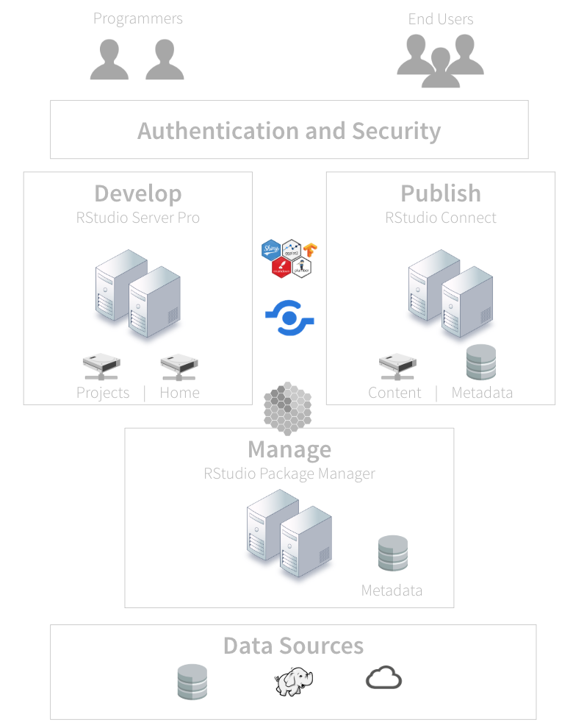
Architecture

Slide 24
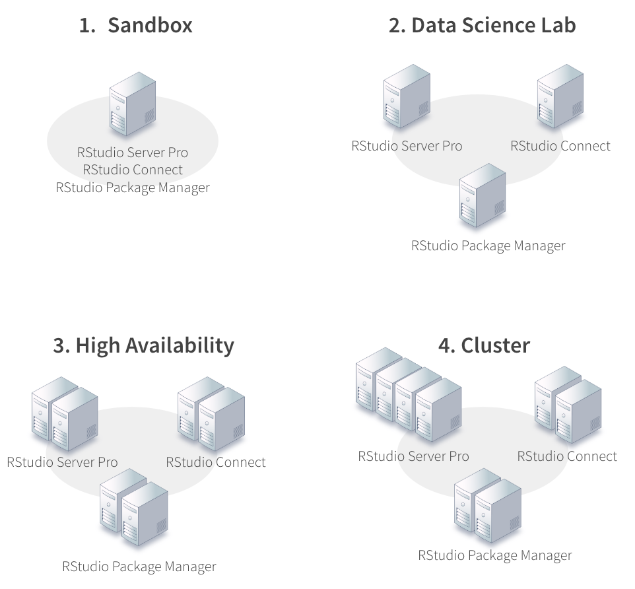
Server Setup

Slide 25
Recipes
Overview
List of ingredients that make up your platform
Helps you organize and automate your work
And are unique to your organization
Structure
Most of your code will be for Linux, R, and R packages
A small part of your code will be for installation
If you’ve installed R properly, installation is usually easy
The rest will be configuration

Slide 26
Infrastructure as code
Organize your recipes so that can manage your platform
Configuration management tools for the R admin
Ansible, Chef, Puppet, CodeDeploy, SaltStack, etc.
Sandbox

Slide 27
What if I’ve never used these products?

Slide 28
RStudio Quickstart
Overview
A virtual machine that runs on your desktop
Includes all our professional products
And includes pre built assets for you to explore and demonstrate to others
Motivation
Experience RStudio professional products
Free and easy
Demo

Slide 29
Summary
The happy path
Keep your operating system and browser up to date
Support multiple versions of R by building R from source
Make sure you have easy access to R packages
Install products as root
Use a supported authentication system
How to get started
Recipes and checklists
Crawl/Walk/Run strategies
RStudio QuickStart

Slide 30
Summary
Connecting with solutions engineering
Community.rstudio.com
Github.com/sol-eng
Solutions.rstudio.com
Support.rstudio.com
Docs.rstudio.com

Slide 31
References
Administration of Pro Products
Professional R Tooling and Integration
The R Admin is Rad
R Admin Community
RStudio Docs
RStudio Professional Product Requirements
RStudio Server Pro Example Checklist
R for the Enterprise
Configuration Management Tools for the R Admin

